Slide 1
Memo Writing: meaning, forms, types and formats
A memorandum (commonly called a memo for short) is a written communication normally reserved for internal messages at business and other organizations.
They also provide a written record of internal communications.
Although memos are usually less formal than business letters, they should be polite and they should communicate information clearly and accurately.
Letters and memos are two common formats for business communications. The general rule is to use letter format when your audience is outside of your organization, and use memo format when your audience is within your organization.
However, often memos are used when communicating with clients and other external parties that you work with frequently.
Memos are often used to :
a)inform others a new or changed policy, procedures, organizational details,
b) announce meetings, events, and changes,
c) present decisions, directives, proposals briefings, and
d) transmit documents( related to internal staff or issue)

Slide 2
Memos are formatted differently from letters:
a) Omit the complimentary openings (Dear Mr. Adhikari:) and complimentary close
(Sincerely, Ram Sharma) that are included in a letter.
b) Omit the mailing and return address (because memos are typically internal- sent between
employees of the same company-no addresses are needed).
c) Label the memo “Memo”, “Memorandum” etc. at the top of the page.
d) If sending hardcopy, initial or sign the memo.

Slide 3
Types of Memos
There are three types of Memos.
Status Memo:-
Status memo informs others of the state of a project or situation. Stay positive and action-oriented as well as realistic
b. Negative memos:-
Negative memos are written to reject, disagree complain etc. While writing a negative memo, remember that it can’t be erased later. Be sure that the message you have written will not be damaging to you or others. Even for writing negative memos, be polite.
c. Personal memos:-
Personal memos are written to convey private and personal information. When writing a personal memo, beware of including confidential information—if read by the wrong person, the message could quickly find its way into the company grapevine.

Slide 4
Main parts of a memo
1) Heading
a. Name of the organization
b. Initial heading-Memo
c. Subheadings
i. To
ii. From
iii Reference No.
iii. Date
iv. Subject
2) Body
3) No salutation or complimentary close
4) Signature
5) Name
6) Post (not compulsory here)
7) CC/Encl.(carbon copy/enclosure)

Slide 5
Memorandum
To: [Audience]
From: [Person and/or Department issuing the memo]
Ref:
Date: [Date Sent]
Subject: [Subject of the Memo]
[Opening – Get to the point in the opening paragraph. Keep things simple and short. Make it easy and fast to read.]
[Summary – Provide enough background so all readers understand the history, but again, keep it simple.]
[Conclusion – End with a call to action.]
CC: [Send copies to anyone affected by the memo.]
Attachments: [List any attachments to the memo. Only list items referred to in the body of the memo.]

Slide 6
Morgan College, Kathmandu
Interoffice Memo
From: The Principal
To: All the students, staff and faculties
Ref. No: 056
Date: 21st June, 2018
Subject: To Attend Football Final Event
It is known that the students from Morgan International college have won the
semifinal and are going to play the final match. The football final is going to be held
on 25th June 2018 at Anfa Complex, Lalitpur. Hence all are requested to participate in the
event as spectators in order to cheer and give moral support to the players.
Buses for the event depart at 12:30 pm on that very day.
…………………..
Dipendra Bhandari
CC:
The Library Section
The Administration Section

Slide 7
Uniglobe College
Baneshwor, Kathmandu
Memo
From: Academic Director
To: All faculty members
Date: 12 may , 2020
Subject: Seminar on Balancing Good Grades and Practical Skills in Management
Uniglobe College is organizing a seminar on “Balancing Good Grades and Practical Skills in Management” detailing as following.
All the faculties of the college teaching in BBA and BBA-BI levels are requested to participate in the seminar. It will help to change teaching strategy to share practical knowledge to students.
Our respected principal sir has requested all the faculties to participate in this seminar. It is compulsory for all of us to attend this seminar. I hope you all will participate. For your kind reference please find the attached notice.
cc: library section
Attachment: Program schedule
؄………………………
Aashish Mishra

Slide 8
Negative Memo
Lakecity College
Gairapatan, Pokhara
Interoffice Memo
From: The Principal
To: All Faculty members
Ref No: 988
Date: 5th Nov 2010
Subject: inability to increase the salary
I received your group application regarding the increment of salary as per the rule
of government. But I am sorry to inform you that in this academic year, we will be
unable to address your proposal since this year the college is constructing its own
building. Besides, I make all of your assure that in the coming academic year, we
will certainly increase your salary.
The college administration is highly grateful to your support and corporation.
……………
Ishwar Malla
Cc:
Non-Teaching staff

Slide 9
Question
Assume that you are heading the Accounts Division of your Company. Prepare a (status) memo for the Chairman of the Company with statistical details concerning the expenditure incurred in the last six months.

Slide 10
Maibu Industires
Interoffice Memorandum
To: Chairman
From: Accountant
Ref: 497/45
Date: November 1, 1999
Subject: Monthly Expenditure on Stationery
In the current fiscal year, the following is the monthly expenditure on
stationery in our company.
As you will recall, we decided to conduct a bi-annual review on monthly
expenditure incurred on miscellaneous items. Information regarding other
items such as travelling and halting allowance, courier charges, electricity
and telephone bills etc are being reviewed.
This is the first in the series of calculation.
Month Expenditure
April Rs. 5000.00
May Rs. 10,000.00
June Rs. 6,000.00
July Rs. 5,000.00
August Rs. 10,000.00
September Rs. 6,000.00
Total Rs. 42,000.00
Average Rs. 7,000
As you can see the average monthly expenditure on stationery is Rs. 7000.00 which is 5%
more than what it was during the corresponding period of the previous year. You will agree
that this exceeds the stipulated increase of 3%.
……………..
Rabi Chandra Sigdel
CC:

Slide 11
Personal Memo
Memo
From: Clara Banden
To: James Kathelin
Date: June 23, 2012
Subject: Suggestion for Improved Memo Writing
James. I’ve just returned from a training seminar titled ‘Better Business Writing.’ Our department manager asked me to share tips I have learned about writing effective memos. Following are the improved memo writing techniques I learned at the training seminar.
Subject Line: one hundred percent of readers read the subject line. Thus, to make this first line of communication effective, include topic (memo writing)
Introduction:- Limit your introduction to one or two sentences. State why you are writing what you are writing about.
Discussion: In the body, develop your points especially (who, what , where and why). Then itemize your point for easy access.
Conclusion: End by telling by reader about what to do next and when to accomplish this task.
By using these techniques, you will be able to communicate more successfully. If you have any questions, please drop by my office. I’d be happy to share information with you.

Slide 12
Exercise for Practice
Assume yourself as the GM of XYZ company. Write a memo to the regional manager of the branch company instructing him or her to submit the annual report of the company before the deadline.
As a manager of Jagadamba Steel, you are worried about the time the employees spend during the lunch break. Draft a memo to be circulated to the employees asking them to be at their desk during their duty hours.

Slide 13
What is Email?
Email is a type of messages distributed by electronic means from one computer user to one or more recipients via a network
Email is the preferred mode of communication in business, both internally and externally. It’s simple, straightforward, secure, and takes place in real time.
Elements of an Email Message
Subject Line. What is the email about? ...
Sender. The email address of the person who sent the message appears here. ...
Recipient. If you are receiving the message, your email address probably won't appear here. ...
Salutation. ...
Email Body. ...
Closing. ...
Signature. ...
Attachments

Slide 14
What does CC mean?
In email sending, CC is the abbreviation for “carbon copy.” Back in the days before internet and email, in order to create a copy of the letter you were writing, you had to place carbon paper between the one you were writing on and the paper that was going to be your copy.
Just like the physical carbon copy above, CC is an easy way to send copies of an email to other people.
What does BCC mean?
BCC stands for “blind carbon copy.” Just like CC, BCC is a way of sending copies of an email to other people.
The difference between the two is that, while you can see a list of recipients when CC is used, that’s not the case with BCC.
It’s called blind carbon copy because the other recipients won’t be able to see that someone else has been sent a copy of the email.

Slide 15
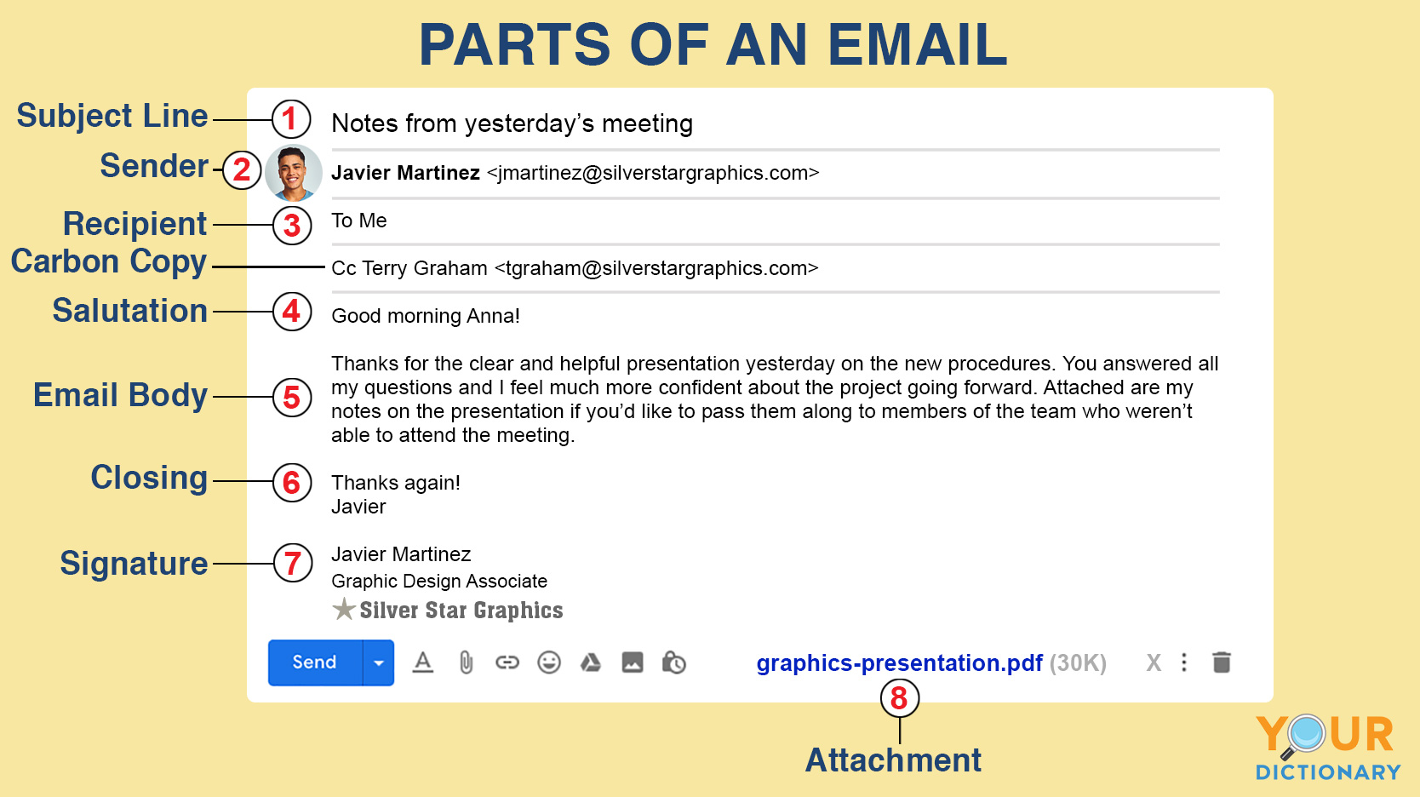

Slide 16
Using Emails:- important form of technical communication medium, Gmail, hotmail, yahoo etc. are free email applications.
Important things to send email letters via the internet are:-
Format:- don’t send long and complex message via email. If you want to send long message, send them with attachments. Don’t use unusual fonts.
Tone:- less formal than standard letters. But business emails need to be formal in tone. But email to friends or colleague becomes informal.
Netiquette:- write in a way that can be read with ease and that can be understood by the reader. Use decent language, it means use legible typeface, color, design etc. borrowing materials from others, give them credit. Use facts but not gossip, avoid over use of emoticons, online slangs and abbreviations.
Language:- Formal business need to use standard language (proper use of grammar, spelling, and capitalization). Don’t use acronyms Gr8, TQ, LOL(laugh out loud) ,BTW( by the way).etc.
Managing your email account: take advantage of useful functions come in email such as sending large documents, notes, images, video, audio clips. Keep up to date with your email otherwise you have to activate it later on.

